Slide 1
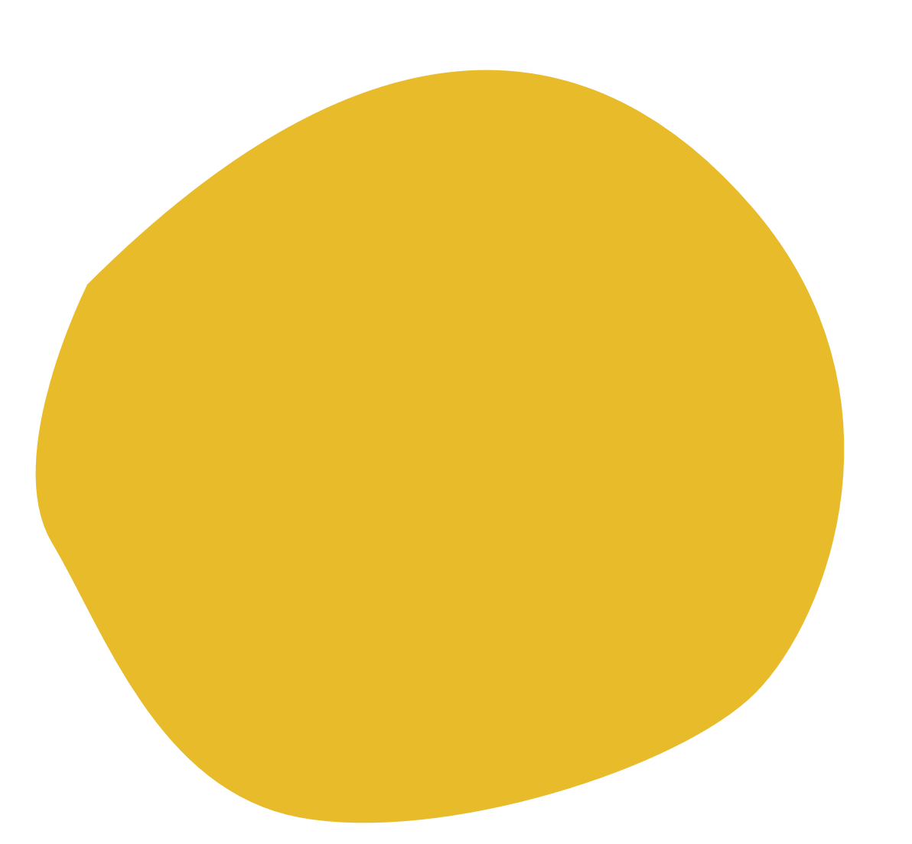


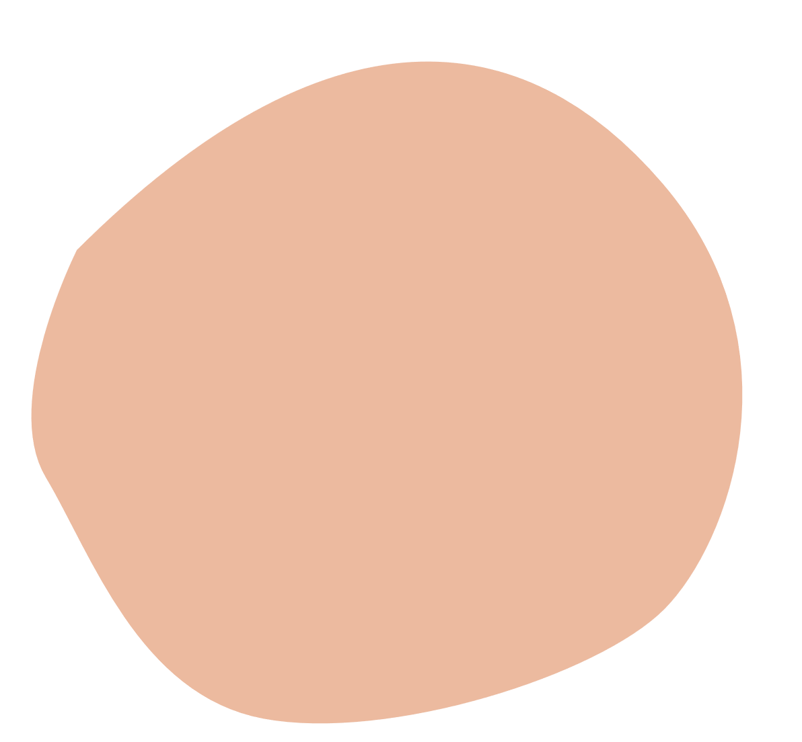




BEAUTY
app developed with android studio.
Work by:
Alhanouf Alhamied
Ruba Al Helal
Jood Alzeydan

Slide 2



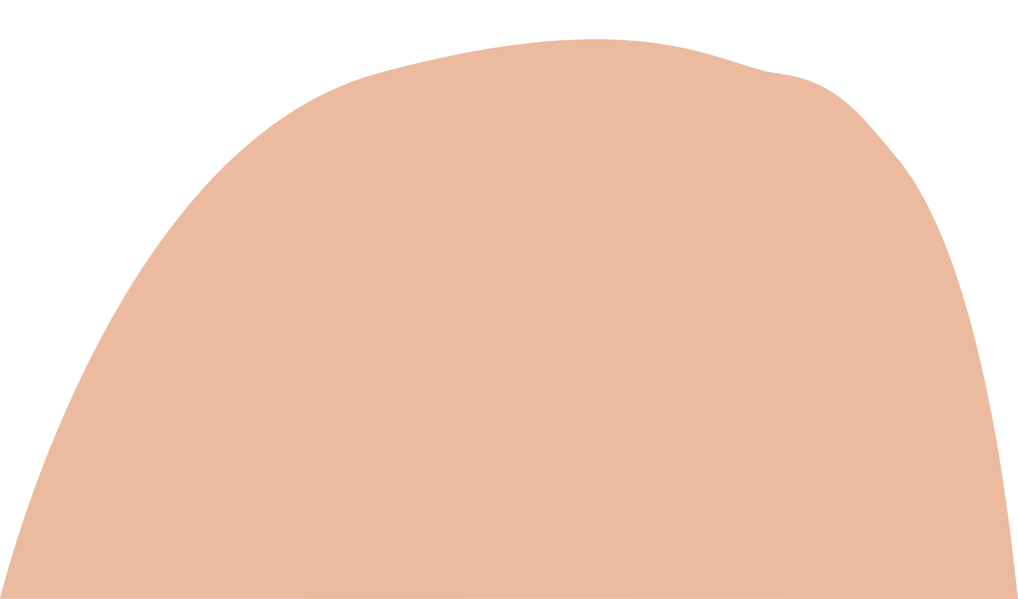

Introduction
The project was developed using android studio and Firebase to serve people interested in beauty products. The products will appear in categories to make the user experiment easy.
View product information such as the product name, image, price and description.
Allow the user to add their product to the shopping cart and to calculate the total price.

Slide 3

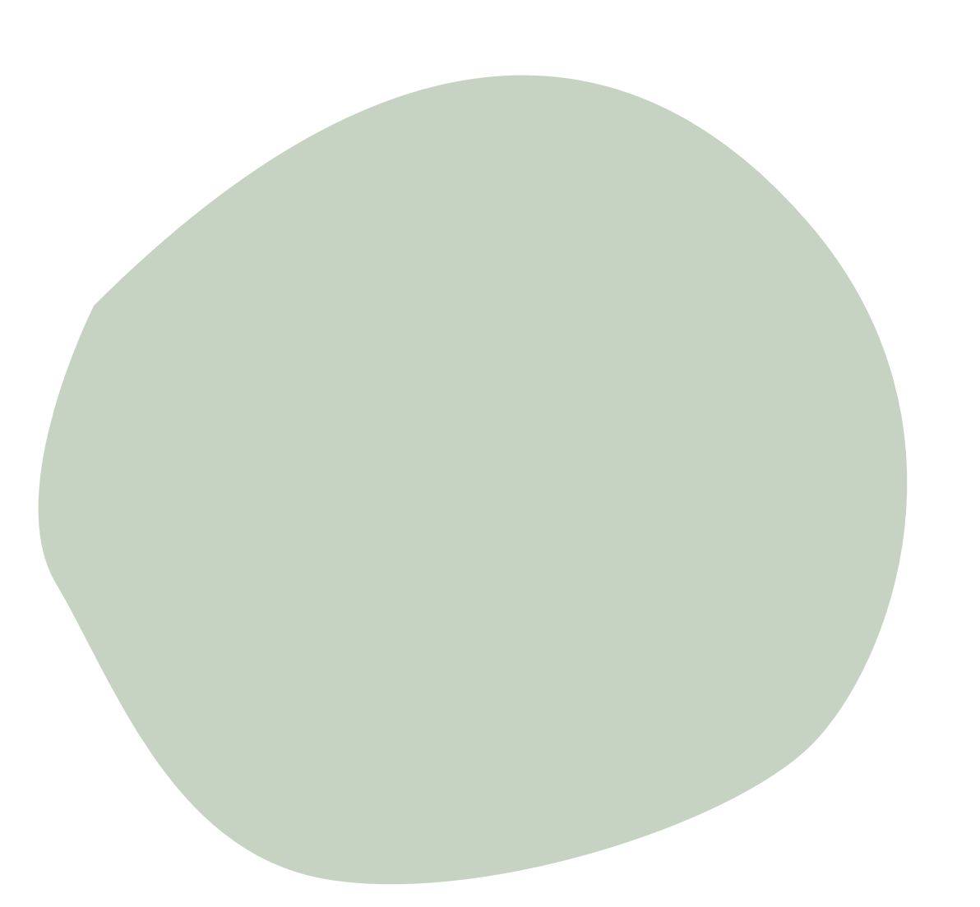

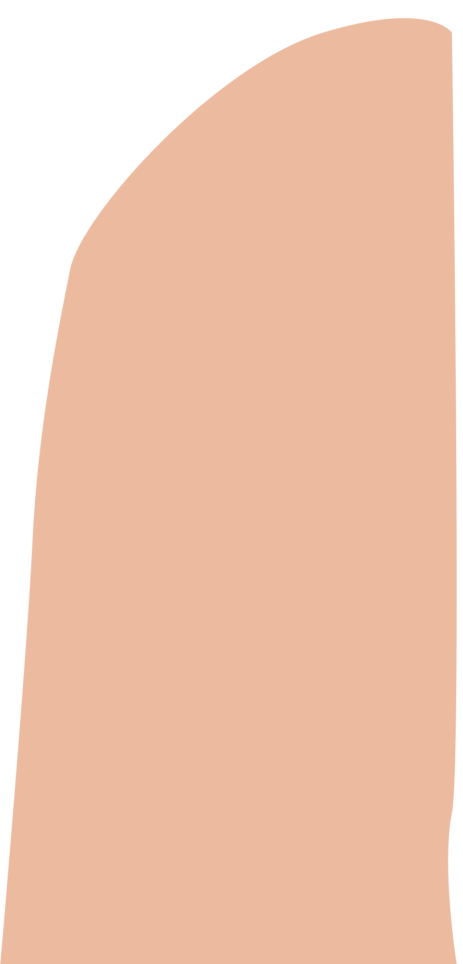


Similar Mobile Applications

Slide 4




Development Environment

Slide 5


Environment Interface
BEAUTY is an app with six main pages which are home, discover, products, product details, shopping cart, about us, and contacts us.

Slide 6
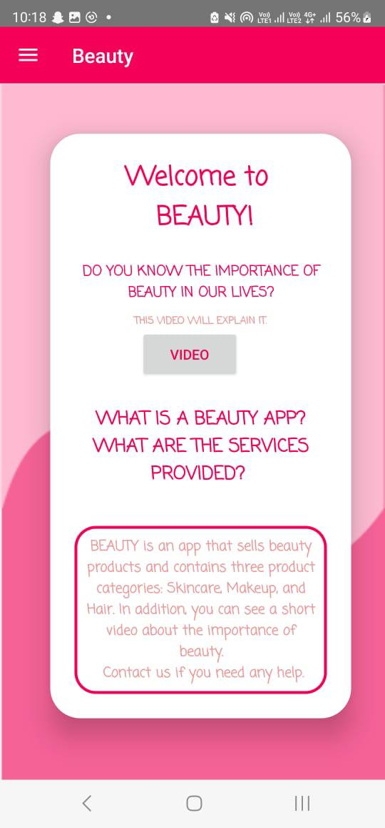
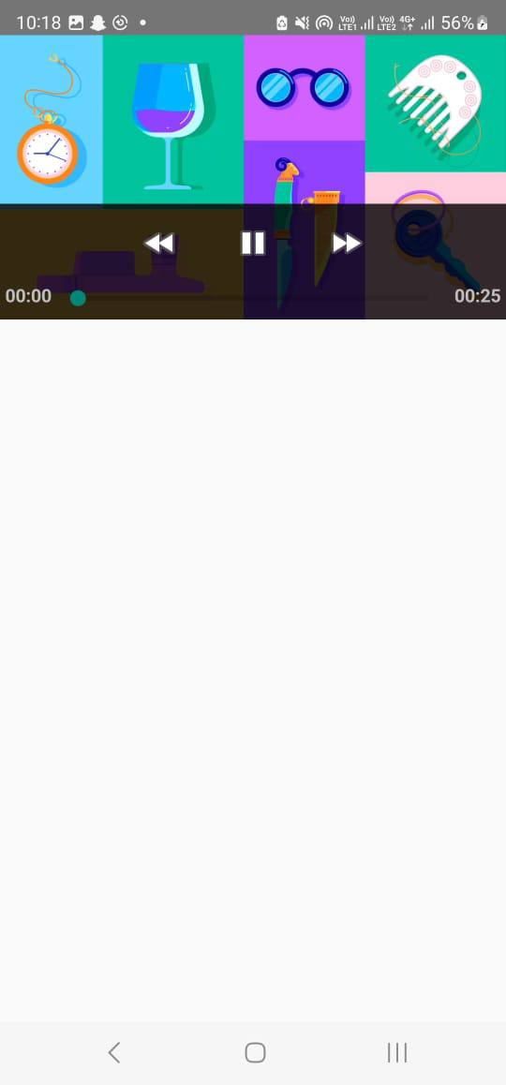
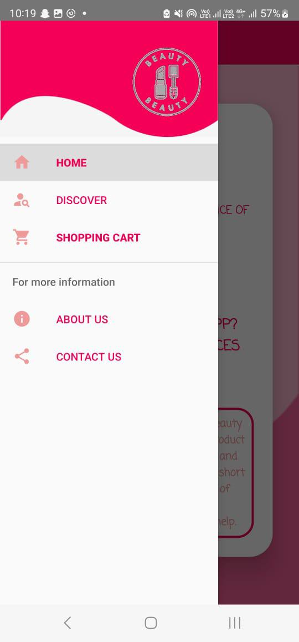


Home page

Slide 7
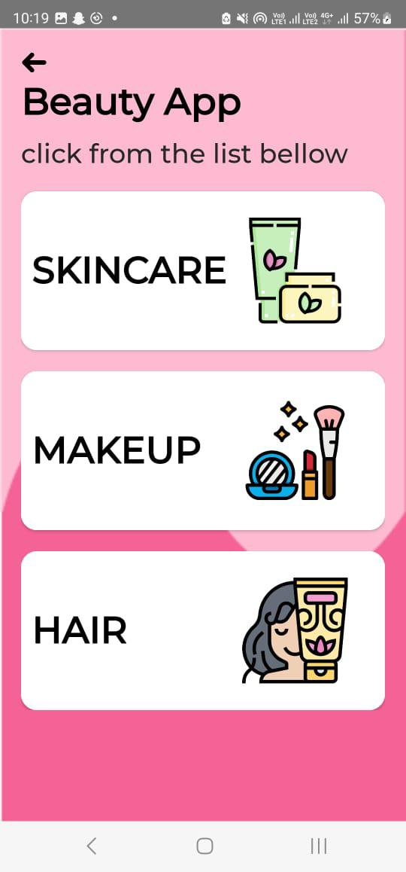


Discover page

Slide 8
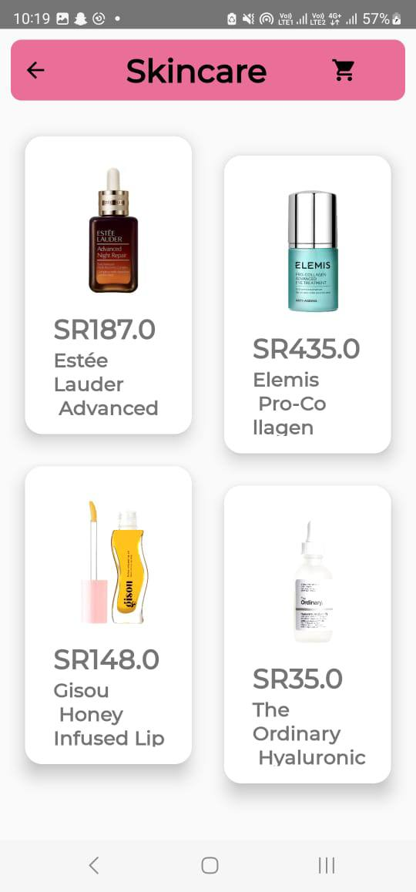
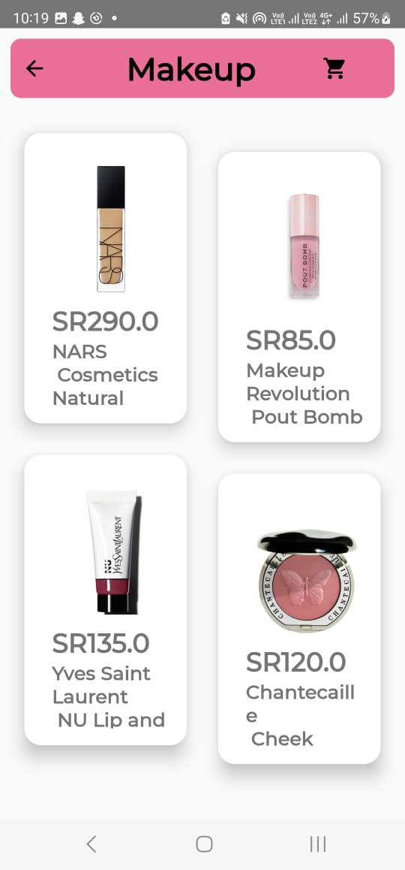
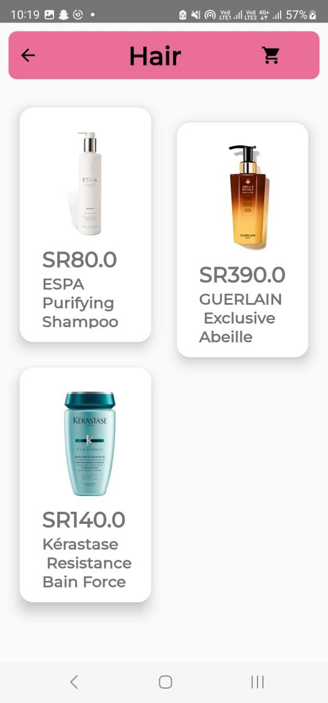
Products page

Slide 9
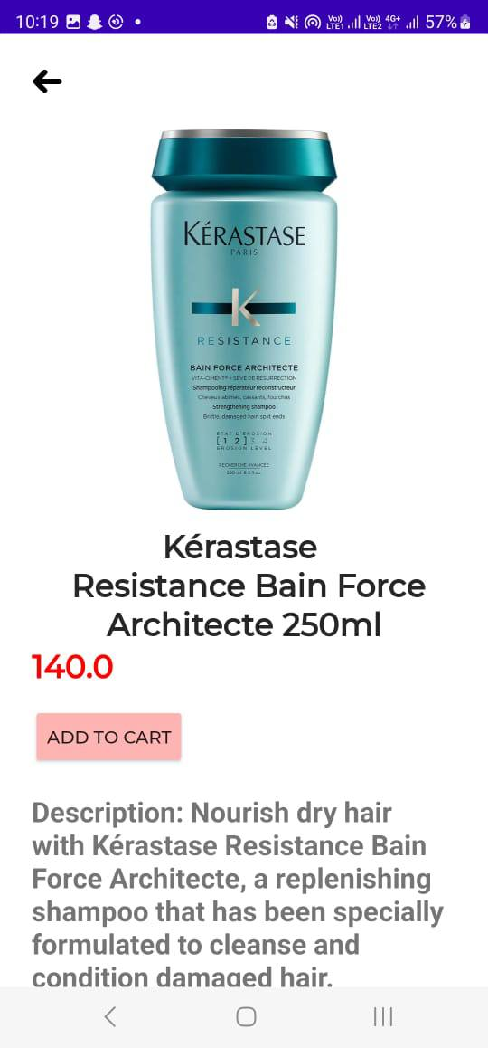
Product Details

Slide 10
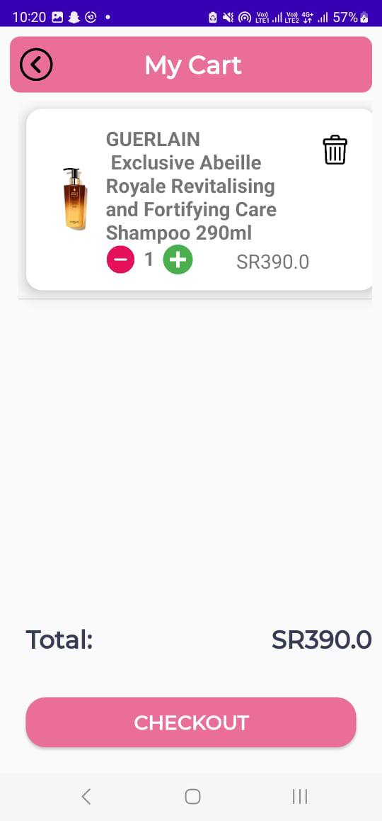
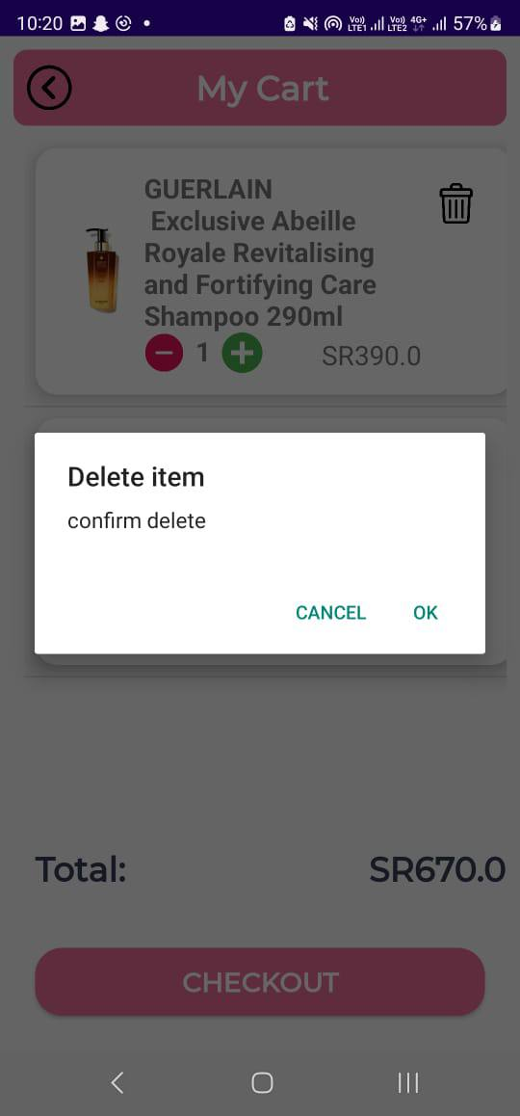
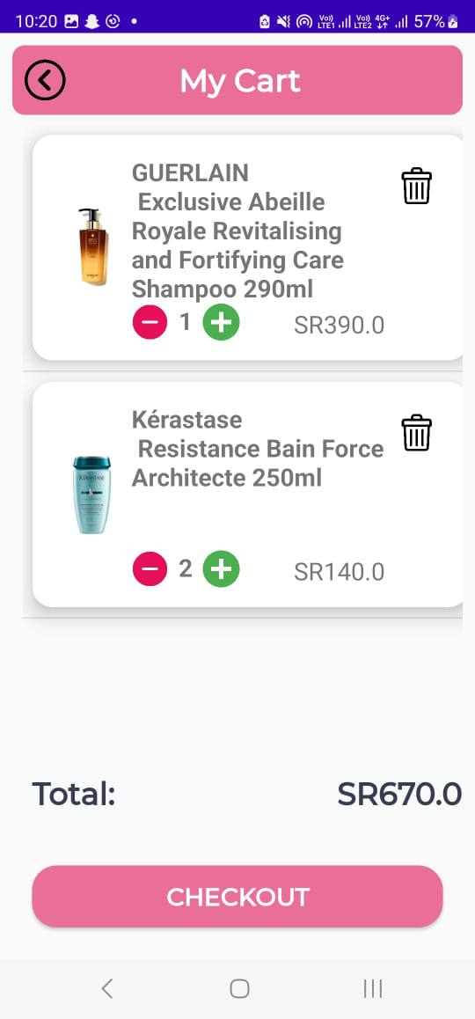
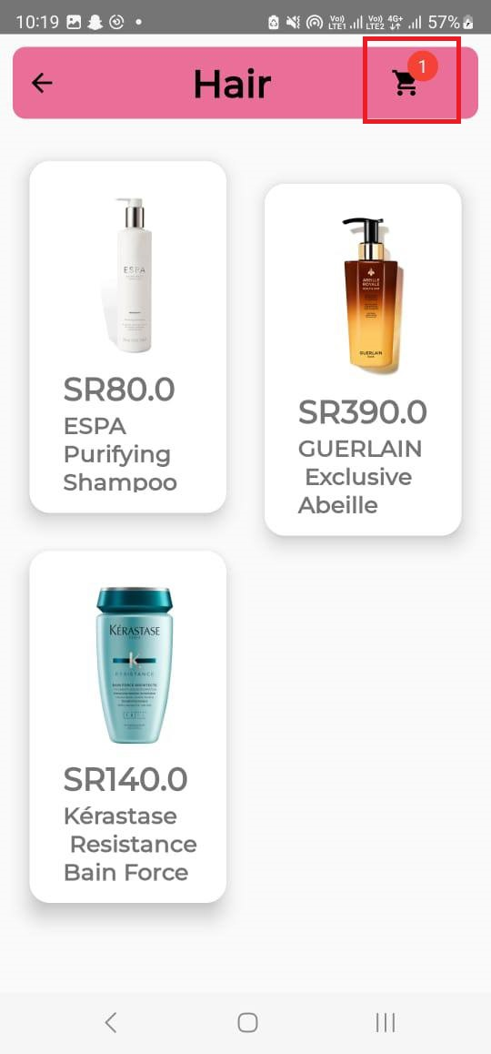
Shopping Cart page

Slide 11
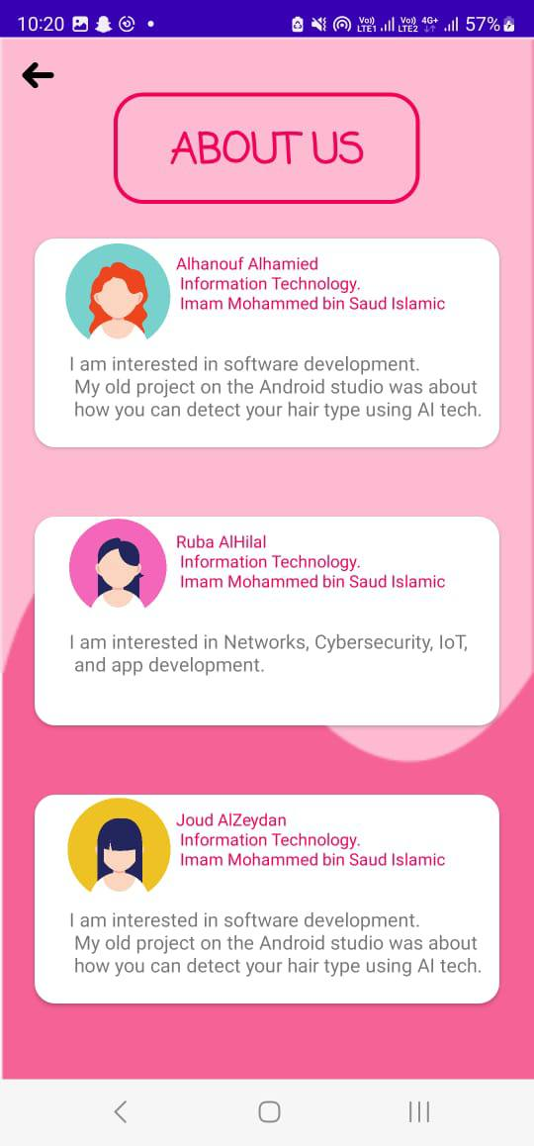
About us page

Slide 12
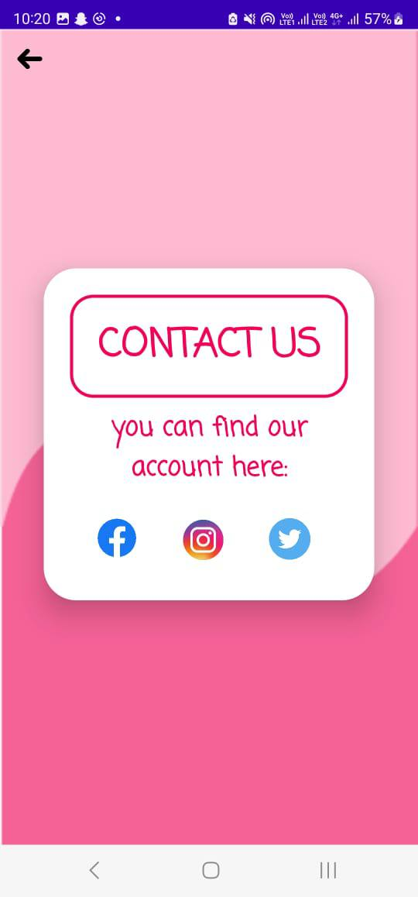
Contact us page

Slide 13
Conclusion
Finally, the main goal of the BEAUTY app is to help people to find what they need from the products easily.
many products appear in various categories such as skincare, makeup, and hair products.

Slide 14
Future Work
Each company has a special section for all its products.
Displaying other people experiences on the product.
Health products.
Trending products.

Slide 15

Thanks!
Any question?

